Slide 1
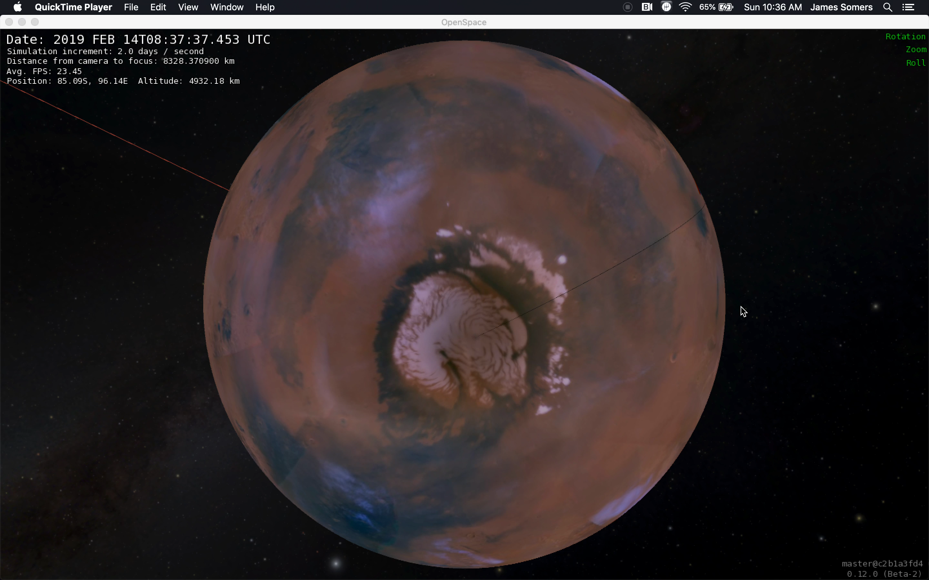
Getting Weather Data to Watney
Partly Cloudy Skies
on Earth and Mars
February 9, 2019
American Natural History Museum
Hack The Solar System
Team Watney

Slide 2

What Would Watney Do?
Download the assets
Understand the data
Transform the assets
Plan for the future
Be a little extra

Slide 3
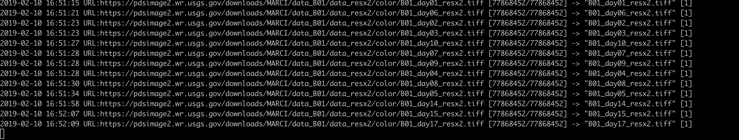
Download the Assets
MARCI data from USGS.gov
Bash script running parallel GETs on the image files
Government shutdown…

Slide 4
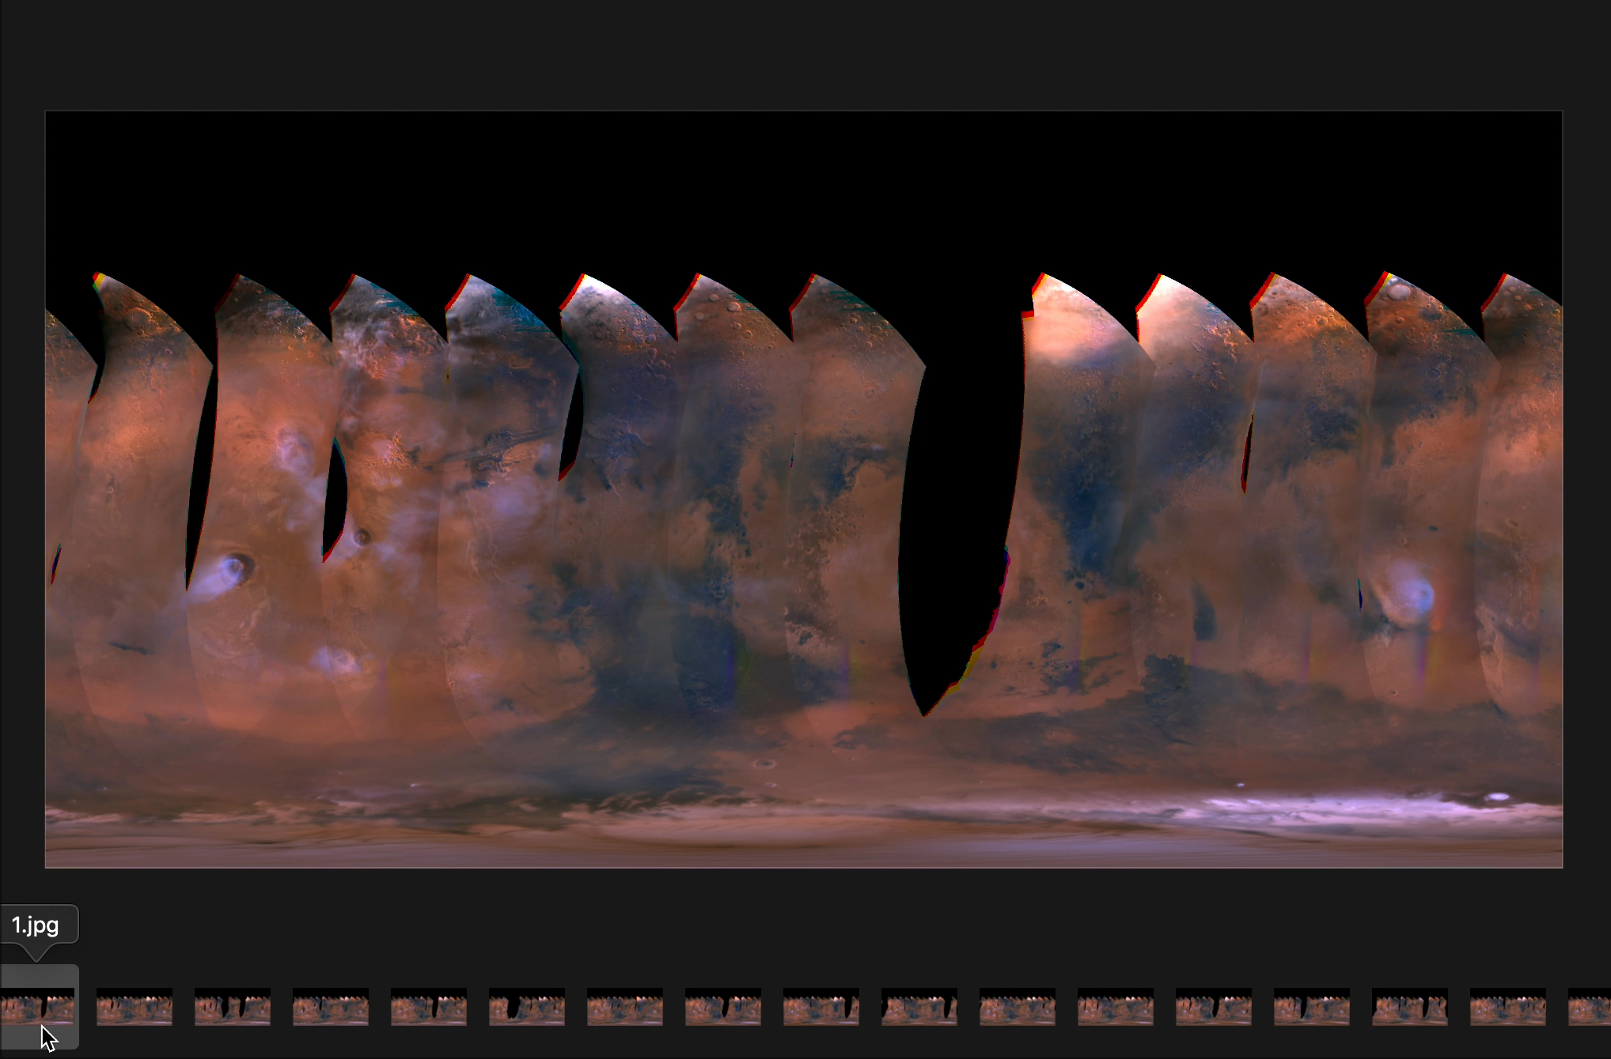
Understand the Data
Convert to color JPEG using GDAL toolchain

Slide 5
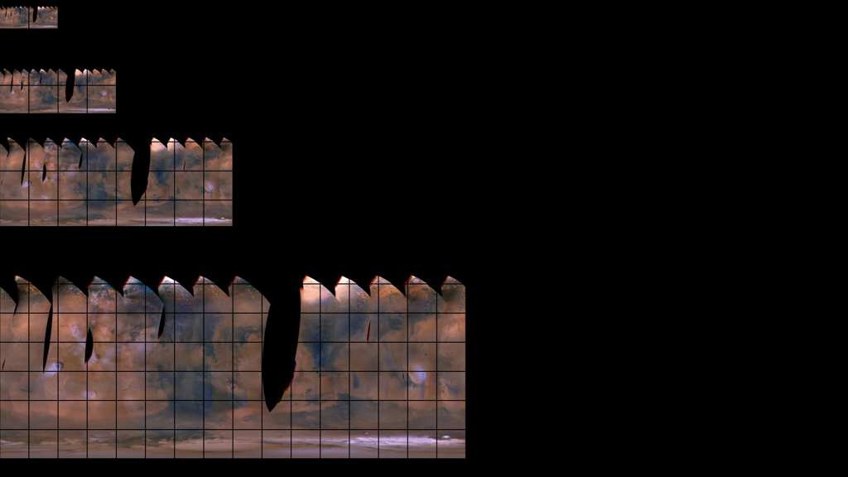
Transform the Assets
Python script to convert each timestamped image to WMS tile directory
Create OpenSpace Temporal Layer XML

Slide 7
Lessons and Future Plans
Easy to add an OpenSpace dataset
Our solution improves on existing Temporal WMS data pipeline
Work with AMNH to host data so anyone can view immediately
Pipeline is general purpose for any planet, any temporal image dataset

Slide 8
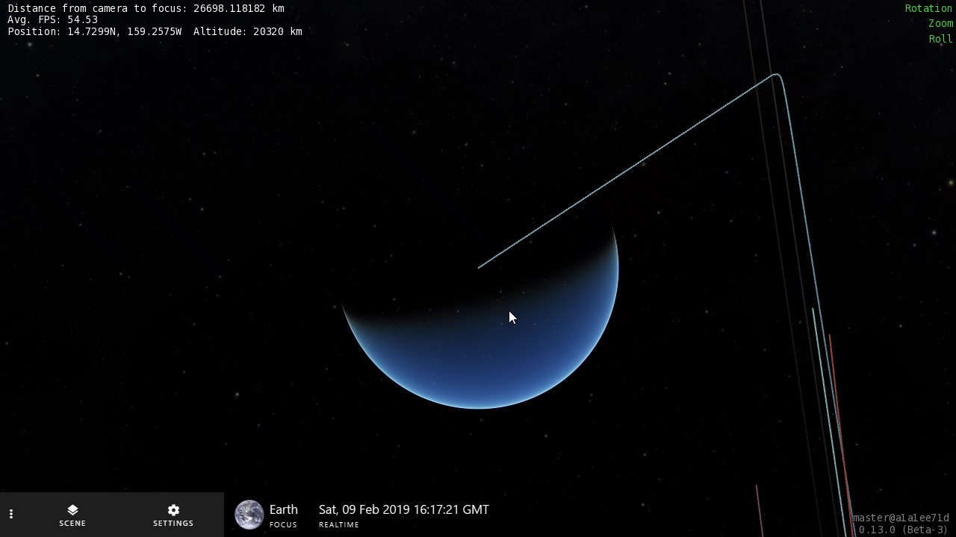
Be a Little Extra
Bonus zoom adjustment patch for 0.13

Slide 9

Team Watney

